Slide 1
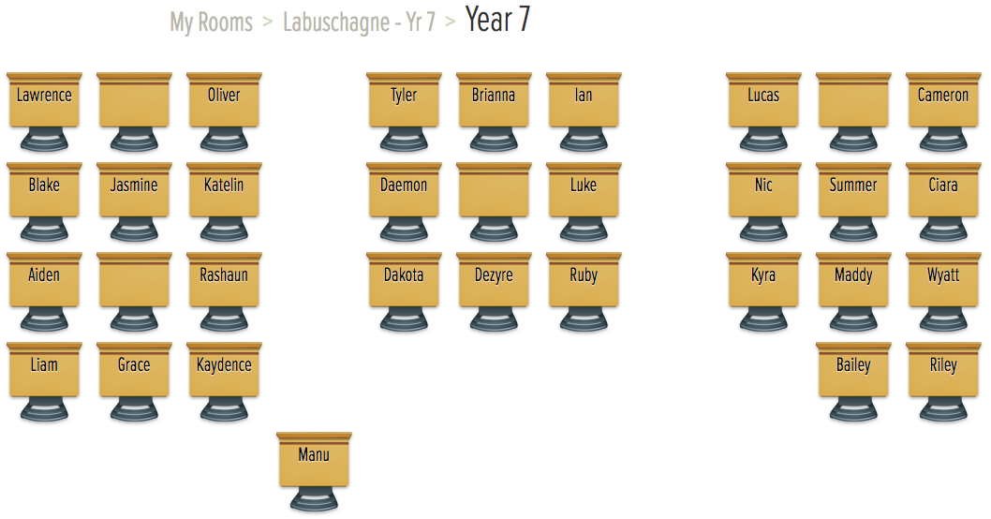

Slide 2
Experimental Probability
Year 7
Week 8
Lesson 3

Slide 3
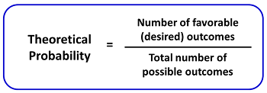
Last Lesson Recap
What is Theoretical Probability?
Theoretical probability is determining the chance of an event occurring
Notes:
• Share with students what they are learning or will be able to do
• Why the lesson is important

Slide 4
24
7
30
Topic: Experimental Probability
Date
EQ – How do we find the experimental probability
What is Experimental Probability?
Is the number of times an event happens over the total number of trials
Experimental Probability =
number of times the event occurred
------------------------------------------------
number of trials

Slide 5
24
7
30
Topic: Experimental Probability
Date
EQ – How do we find the experimental probability
Difference between Theoretical and Experimental Probability
Theoretical probability is what we expect to happen
Experimental probability is what actually happens when we try it out.

Slide 6
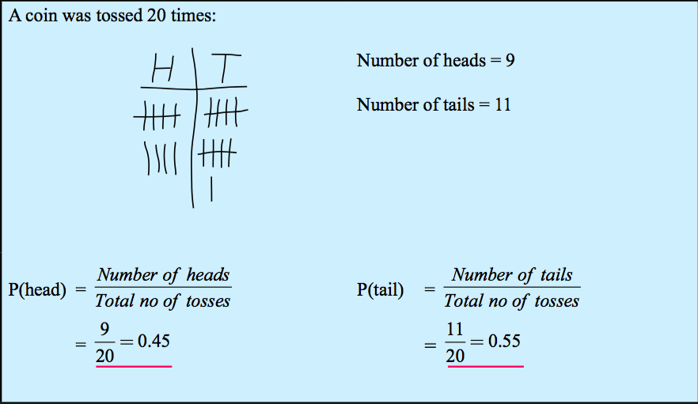
Examples
Notes:
• Give students the opportunity to practise with teacher guidance
• Provide immediate and specific feedback with knowledge of results

Slide 7
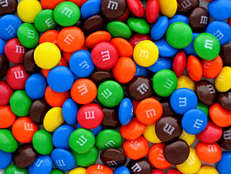
M&M Experiment
Which color are you most likely to get?

Slide 8
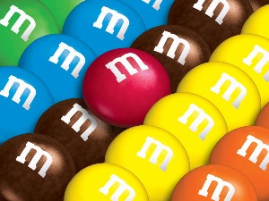
Step 1
Glue the table into your book on the task page
Count the number of all M&Ms in your packet
Count the number of M&Ms for each color.
Fill in your table

Slide 9

Step 2
Analyze your results by responding to the following questions.
According to your results, which color is most likely? Which color is least likely?
What is the sample space for picking an M&M in your package?
Is picking a blue or orange candy more likely? Why?
Do you have any colors that have equally likely outcomes? Explain!
What is the probability of:
  picking an orange M&M?
  picking an orange or a yellow M&M?
  not picking an orange M&M?
  not picking an orange or a yellow M&M?
Did we calculate and examine theoretical or experimental probability? How do you know? Elaborate!!!

Slide 10
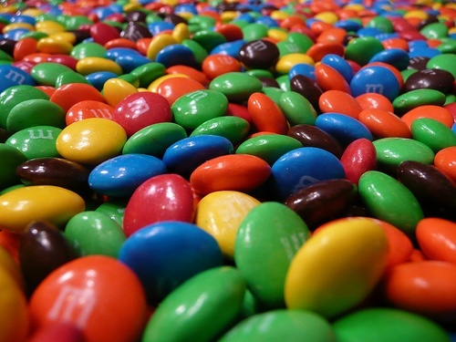
Step 3
According to the M&M website, each package of milk chocolate M&M contains…
  24% Blue
  14% Brown
  16% Green
  20% Orange
  13% Red
  14% Yellow
How does your M&M data compare to the theoretical data?
You can now EAT your M&Ms

